Slide 1

The Nature of the Social Sciences
Allegory, Poetry, and Pluralism
James E. Faulconer
The Sharon Institute
20 September 2025

Slide 2
Framing the Question
What makes the social sciences different from the natural sciences?
Natural sciences: laws, formulas, predictions
Social sciences: meaning, culture, relationships

Slide 3
A Tentative Answer
Social sciences as allegory & poetry
Not a failed versions of physics
Advantage: resonates with Latter-day Saint teaching

Slide 4
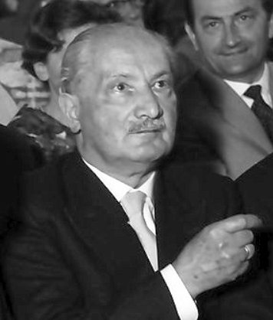
Heidegger on Technology
Technology ≠ just tools
Technology as enframing
The world revealed as a resource
Martin Heidegger (1960) — CC BY-SA 3.0

Slide 5

Examples of Enframing
River = hydroelectric power
Forest = lumber or recreation
Workers = labor inputs
Consumers = data to be harvested

Slide 6

The Danger of Technology
Since nothing outside its frame:
Everything reduced to usefulness
No good in itself
World flattened, meaning lost
Nihilism

Slide 7
Beyond Enframing
Technology is necessary but insufficient for much understanding
Danger: it becomes the only way of seeing
We need alternatives

Slide 8
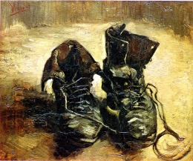
Poetry as an Alternative
Poiesis = bringing-forth and letting-be
Poetry lets the world show itself
Van Gogh’s shoes: more than an object

Slide 9

Allegory as Alternative
Bernard Silvestris: allegory fuses interpretation & creation
Allegory is not illustration, but medium for new meaning
Social theories = allegories

Slide 10
Allegory & Social Science
Theories imagine the world in new frames:
e.g., system, struggle, ritual, network
They are provisional, fragile, fertile

Slide 11

Gadamer on Meaning
Meaning is temporal, not static
Fusion of horizons: past & present meet in new meaning
Understanding unfolds in dialogue

Slide 12

Rückert’s Insight
“Each interprets the world in his own way, / and each interprets rightly; so much meaning is in it.”
Reality: thick, inexhaustible
Multiple true ways of seeing

Slide 13
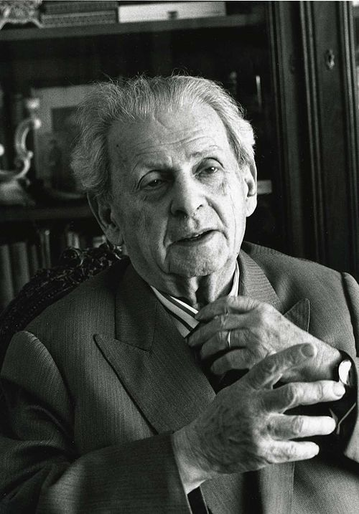
Levinas on Responsibility
Ethics = fundamental philosophy
Others cannot be reduced to objects
Responsibility unavoidable & beyond calculation
© Bracha L. Ettinger — CC BY-SA 2.5

Slide 14
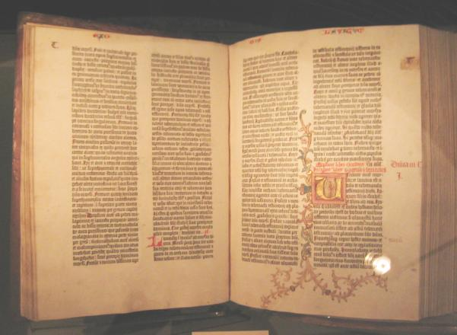
Scripture & Social Science
Restoration scripture: everything we study is material
Thick reality → many revelations of truth
Covenant means responsibility

Slide 15
Implications for social science
Pluralism: multiple truths, including the truth of revelation
Humility: no final human interpretation
Responsibility: theories shape lives

Slide 16
Conclusion
Social science ≠ failed natural science
Done well, they are allegory & poetry about human meaning: temporal, plural responsible (in Levinas’s sense)
Truth is not exhausted by one discourse

Slide 17
To be human is to live in the surplus of meaning
To do social science requires receiving, interpreting, and living in that surplus faithfully

